Slide 1

INTERNSHIP on “DATA SCIENCE WITH AIML”
Jain College of Engineering, Belagavi, 590 014
Department of Electronics and Communication Engineering
Name: Naveen N Naganuri Dr. Rajashekhargouda Patil
USN: 2JI20EC072 Internal Guide
Mr. Hemesh Muniraju
External Guide

Slide 2
INDEX
Sl. No. | Topic
1 | Objective of the Internship
2 | Internship details
3 | Work/Task/Project Performed -The Implementation/Results
4 | Skills Acquired/Tools & Techniques learned
5 | Internship impact
6 | Conclusion

Slide 3
OBJECTIVE OF INTERNSHIP
Analyze and evaluate the fuel efficiency of different car models to determine which ones are the most fuel-efficient.
This can help consumers make informed choices when purchasing a car.
Examine historical data to identify trends in fuel economy over time.
This can be useful for understanding how fuel efficiency has evolved in the automotive industry.
Investigate the factors that influence a car's fuel economy, such as engine size, weight, transmission type, and driving conditions. This can help manufacturers and consumers understand what design and usage factors impact fuel efficiency.
Calculate and compare the environmental impact of different cars in terms of emissions and fuel consumption. This is important for sustainability and reducing the carbon footprint
Develop predictive models that can estimate a car's fuel economy based on its specifications and usage patterns. This can be valuable for both manufacturers and consumers.

Slide 4
Internship | From 16/08/2023 to 12/09/2023
Mode of Internship Online/Offline | OFFLINE
Student name | Naveen N Naganuri |  | USN: 2JI20EC072
Semester and Division | 7th Semester C div
Subject Name |  |  | Sub Code:
Name of the Internal Guide | Dr. Rajashekhargouda Patil
Name of the External Guide | Hemesh Maniraju Sir
Organization Name | Cranes Varsity Private Limated
Organization Address | # 82, Presidency Building, 3rd & 4th Floor, St Mark's Rd, Bengaluru, Karnataka 560001
Domain | Data Science with AIML
External Guide Mobile No | 9513386949 | Email ID: hemesh.muniraju@gmail.com

Slide 5
WORK PERFORMED
Pandas: The library helps to load the data frame in a 2D array format and has multiple functions to perform analysis tasks in one go.
Numpy: Numpy arrays are very fast and can perform large computations in a very short time.
Matplotlib: This library file is used to draw visualizations
Tensorflow: This is an open source library that is used for Machine Learning and AI and provides a range of functions to achieve complex functionalities with single lines of code

Slide 6
PROJECT PERFORMED
In this project we will learn how can we build a fuel efficiency predicting model by using TensorFlow API(Application programming interface). The dataset we will be using contain features like the distance engine has traveled, the number of cylinders in the car, and other relevant feature.
Predicting fuel efficiency is crucial for optimizing vehicle performance and reducing carbon emissions, and this can easily be predicted using tensorflow, a library of python.
We should specify the column names and handle any missing values, separate the dataset into features and labels, separate the dataset into two parts features (Input variables) and labels (Output variable).
Import the necessary libraries like numpy, pandas, tensorflow and matplotlib

Slide 7
PROJECT PERFORMED
import numpy as np: This line imports Numpy library and gives it the alias “np”. Numpy is commonly used for numerical operations and working with arrays in python.
import pandas as pd: This line imports the pandas library and gives it alias “pd”. Pandas is used for data manipulation and analysis.
import matplotlib.pyplot as plt: This line imports the matplotlib library and gives it the alias “plt”. Used for creating various types of plots and visualizations.
import seaborn as sb: Seaborn is a data visualization library build on top of matplotlib, providing a highlevel interface for creating attractive and informative statistical graphics.
import tensorflow as tf: This line imports the tensorflow library, a popular deep learning framework for building and training machine learning models.

Slide 8
PROJECT PERFORMED
Data collection: Obtaian a dataset containing information about the different car models, including variables like fuel efficiency, engine size, weight, transmission type, etc
Data processing: Check for missing values and handel them, clean and format data for consistency
Exploratory data analysis: Explore relationships between fuel economy and other variables. For example, analyzing how fuel economy varies with engine size, weight, or transmission type.
Data visualization: Create informative plots and graphs to visualize the relationships and trends. This can include scatter plots, regression lines, and residual plots
Model evaluation: Access the quality of the regression models using metrics
Visualization of Results: Create final data visualizations and plots to present your findings in a clear and accessible.

Slide 9
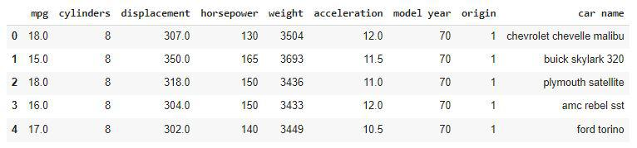
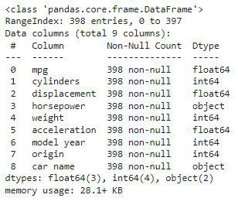
PROJECT PERFORMED
Analysis:

Slide 10
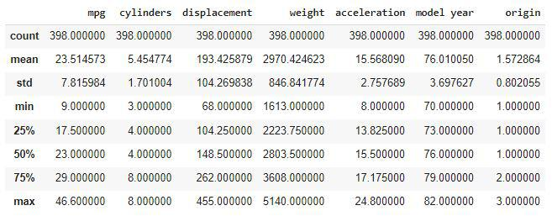
PROJECT PERFORMED
Analysis:

Slide 11
SKILLS ACQUIRED & TOOLS USED
Understanding workplace culture.
Time management
Teamwork and collaboration
TOOLS USED: Google Colab
Google Colab is the cloud based platform provided by google for running python code in a collaborative and interactive environment. It offers several features.

Slide 12
INTERNSHIP IMPACT
Communication, teamwork, and time management skills are often honed during internships, it can boost your self – assurance, as you gain real – world experience and demonstrate your capabilities.
We can connect with professionals in the company, potentially leading to job opportunities or mentorship.
Internships allow us to apply classroom knowledge to real – world situations, enhancing your skills and understanding of your field.

Slide 13
CONCLUSION
Concluding my DS/ML internship has been a transformative journey. I've gained knowledge in machine learning algorithms, data analysis, and programming, as well as practical experience in real-world DS applications. Through projects and supportive mentors, I've honed my problem-solving skills and acquired the ability to work collaboratively.

